Slide 1
ACTV8me’s engagement and attribution platform connects marketing to transactions

Slide 2
Generic QR Code
Sequential QR Code™ (SQR Code™)
Share content (images, video, social media) to enhance brand messaging and loyalty
Serve unique promotions or messaging based on the user’s location through one SQR Code™
CCPA, GDPR and IAB-certified for a brand-safe, opt-in experience
Program sequenced or randomized outcomes based on the distribution channel, time of day, user’s location and/or number of scans
One Outcome
Unlock push notifications through ACTV8me’s native mobile wallet integration (Apple Pay/Google Pay)
Collect first-party data through prizing, sweepstakes, and submission forms
Generate real-time feedback through instant polling and quizzes
Optional scratcher layer for a surprise-and-delight reveal

Slide 3
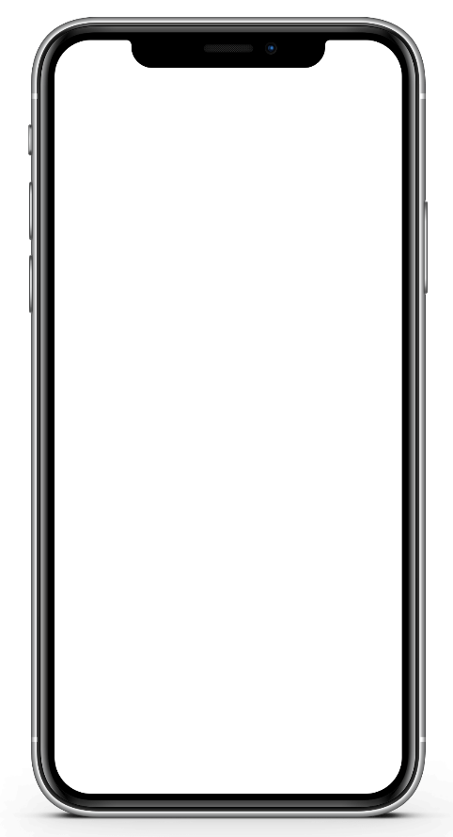
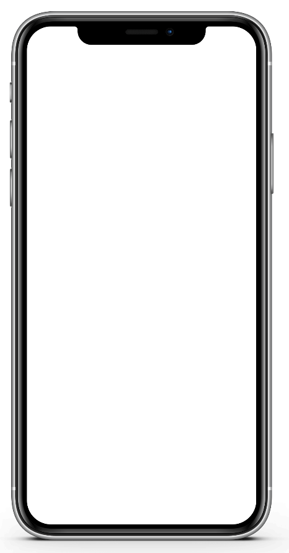
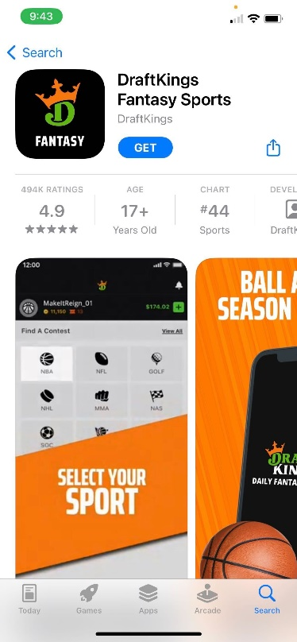
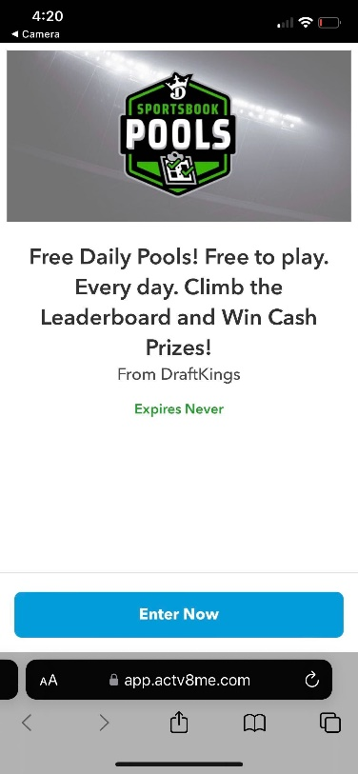
DraftKings Can Amplify their DOOH efforts with an SQR Code™
Consumers are encouraged to scan the Sequential QR Code™️ (SQR Code™️) across the ad campaign to unlock a personalized experience that maximizes engagement. The platform can decipher if a consumer has the app installed or not and based on that information, we can curate a personalized consumer journey.
OR
DraftKings can drive traffic to the app store for immediate downloads or provide incentives to all users through one SQR Code™️ activation.

Slide 4
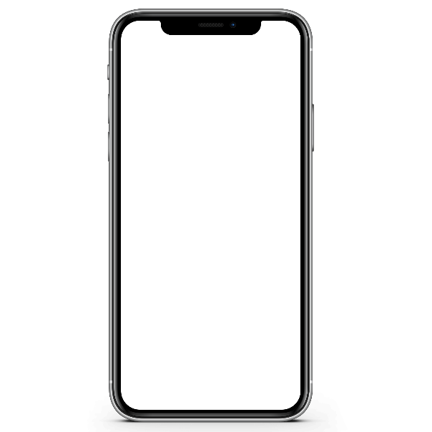
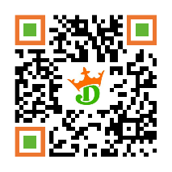
DraftKings: Supercharge Ad Campaigns with a Customer-Centric Approach that Boosts Engagement and ROI Users can point their cell phone cameras at the SQR Code™️ and are redirected to the native app store where they can immediately download the app. DraftKings can optimize campaigns by embedding a performance-based code and include a specific call to action. The SQR Codes™️ serve as an opportunity to drive awareness, engagement and drive traffic to the application.
Consumer Journey 1
User scans SQR Code™️
User is driven to native app store for immediate download.
User authenticated
Scan tracking (# of scans)
URL or scan methodology
Unique impressions
Location and locale identified
Drive to native app stores
# Of Site views
Sequential offer/information delivered based on interactions
Device type (iOS/Android)
Time of day
Engagement rate
Engagement by media source activation
A/B testing
KPI’s Measured:

Slide 5
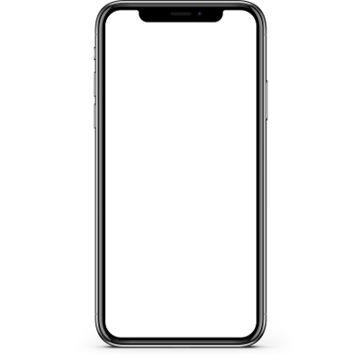
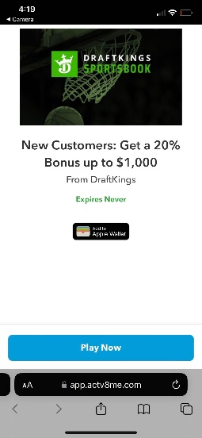
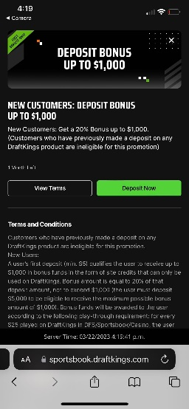
DraftKings: Create a Unique Interactive Experience that Incentivizes Users to Keep Playing Users can point their cell phone cameras at the SQR Codes™️ across the ad campaign and based on whether they already have the DraftKings app downloaded onto their device, users can be taken to landing pages promoting a variety of incentives for new and existing users. DraftKings can motivate additional downloads and retain current players with this DTC approach.
Consumer Journey 2
1 Free Class
User scans SQR Code™️
User is brought to a microsite hosted by ACTV8me with optional native mobile wallet integration.
User can take advantage of the DraftKings incentives online.
User authenticated
Scan tracking (# of scans)
URL or scan methodology
Unique impressions
Location and locale identified
Drive to native app stores
# Of Site views
Sequential offer/information delivered based on interactions
Device type (iOS/Android)
Time of day
Engagement rate
Engagement by media source activation
A/B testing
KPI’s Measured:

Slide 6
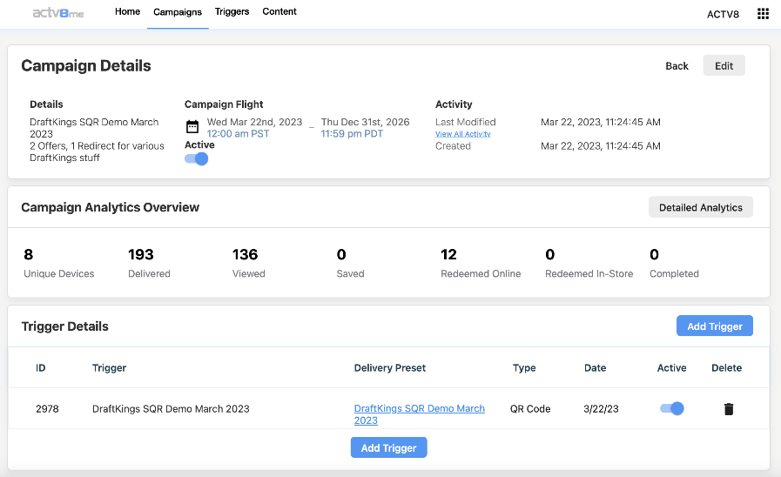
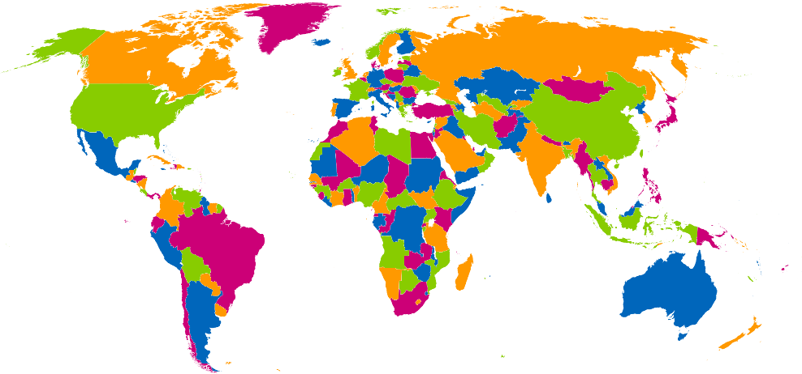
ACTV8me Platform Can Drive a Diverse Campaign Across Multiple Markets/Territories Simultaneously
Leveraging one Sequential QR Code™ across any touchpoint, marketing collateral, ad campaign, or sponsorship, ACTV8me’s multi-tenant dashboard can configure, manage and report on unique experiences in real-time. ACTV8me can parse out these experiences by time, location, and the number of scans.

Slide 7
SCAN, SAVE, REMIND & REDEEM
Key Performance Indicators
Awareness:
Impressions Delivered
Unique users
Demographic data: age, gender, location
Device Platform (iOS/Android) and Device IDs
Media consumption behavior
Consideration:
Offer pending
Offer declined
Offer deleted
Offer saved to wallet
Offer expired in wallet
Time of day consumer interacted with offer
Action:
Click to redeem
Sales (online/in-store)
Purchase intent lift
(In addition to any 3rd party data sets)
Our platform is GDPR, CCPA & IAB Compliant

Slide 8
CONTACT INFORMATION ECM MEDIA LLC
Mathew O’Brien
mathew.obrien@ecmmediallc.com
262-308-9442

